Slide 1
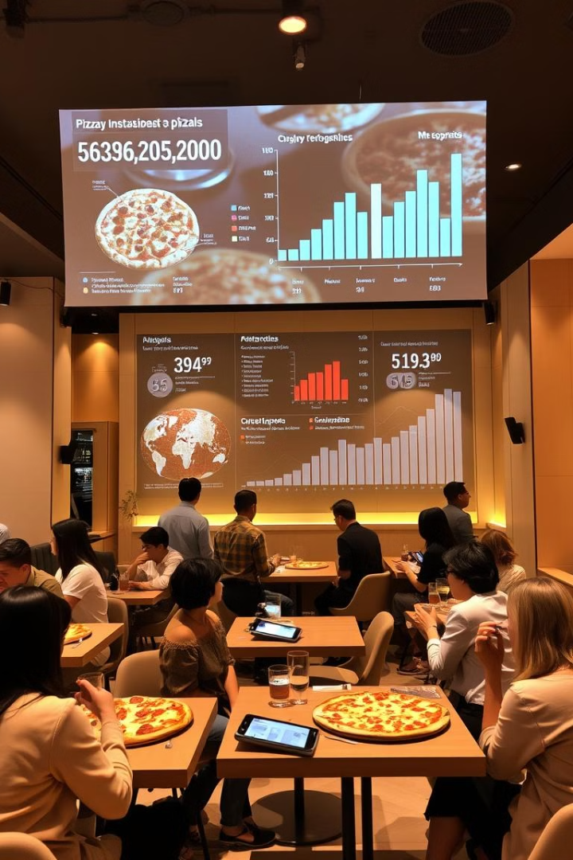
Sales Performance Analysis: Data-Driven Insights for Revenue Growth
Leveraging Power BI for Strategic Decision-Making
Prepared by: Rajendra Singh Shah

Slide 2

Table of Contents
1
Introduction
Overview of the problem and background information.
2
Goals and KPIs
Specific objectives and key performance indicators for the analysis.
3
Recommended Analysis
Detailed examination of customer traffic, order composition, revenue, and menu optimization.
4
Conclusion
Summary of findings and potential next steps.

Slide 3
Introduction
Problem
Solution
Data Source
The company lacks a centralized view of sales performance across products, customers, and regions.
This limits decision-making in marketing, inventory, and revenue strategy.
A Power BI dashboard was built to track sales KPIs, trends, and segment performance in real-time. It empowers business teams with actionable insights to improve sales and strategy.
Data includes orders, products, customers, budgets, and calendar tables from 2023 to 2025 stored in database. Data was cleaned and modeled using Power Query and analyzed with DAX in Power BI.

Slide 4

Goals and KPIs
1
Goal: Increase Total Sales by 15% Year-over-Year
KPI: Total Sales Revenue
2
Goal: Improve Profitability by Reducing Underperforming Products
KPI: Sales Variance by Product Category
3
Goal: Identify and Retain High-Value Customer Segments
KPI: Sales by Customer Age, Income & Marital Status
4
Goal: Track Monthly Sales Trends Against Budget
KPI: Monthly Sales vs. Budget Comparison
5
Goal: Optimize Inventory Based on Product Demand
KPI: Top 10 Products by Sales, Sales by Size and Color

Slide 5
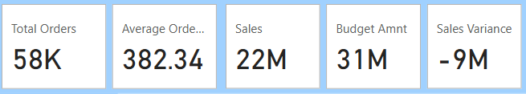
Sales Overview - KPI Dashboard
Total sales reached $22M over 3 years, falling $9M short of the $31M target.
The dashboard displays key KPIs: revenue, number of customers (18K), total orders (58K), and average order value ($382.34).
The variance between sales and budget amount (-$9M) indicates the need for more strategic interventions.

Slide 6
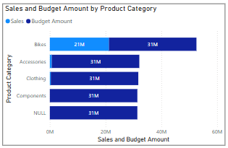
Sales vs. Budget by Product Category
Bikes dominate sales, contributing $21M to the total revenue.
Accessories, Clothing, and Components each have $31M budgeted but actual sales are not reflected, indicating a need to reassess strategy and focus on high performance categories.
Sales for Bikes are high, indicating a strong product category which needs to be maintained for sales and revenue.

Slide 7
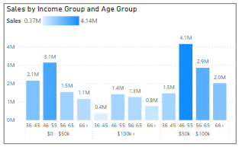
Customer Segmentation – Age & Income
Customers aged 36–55 of $50k - $100k income group generate the most sales by contributing $7M of sales.
Customer aged 36-55 of $0 - $50k income group contributes $5.2M.
The 46-65 age group with an income over $100k contributes $2.7M.
These segments should be prioritized for future promotions and retention efforts.

Slide 8
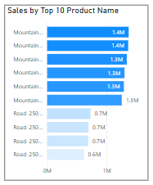
Product Performance – Top Products
Mountain-200 (Black & Silver) models dominate product sales.
Individual product sales range from $0.6M to $1.4M.
Inventory and marketing strategies should prioritize these models.

Slide 9
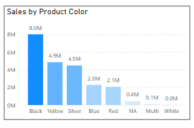
Sales by Product Attribute - Color
Black, Yellow and Silver are the most popular product colors.
This insight will drive inventory and marketing strategies based on color.
Prioritizing black, yellow and silver products will meet customer demand, and prevent lost sales.

Slide 10
Sales by Product Attribute - Color
Black, Yellow and Silver are the most popular product colors.
This insight will drive inventory and marketing strategies based on color.
Prioritizing black, yellow and silver products will meet customer demand, and prevent lost sales.

Slide 11
Conclusion
This analysis highlights the importance of strategic decision-making informed by data.
The insights derived from the Power BI dashboard provide a foundation for optimizing sales strategies, targeting key customer segments, and prioritizing high-performing products.
Recommendations include targeted sales efforts, customer retention strategies, and optimized inventory management.
By implementing these recommendations, the company can enhance sales performance and achieve its financial goals.

Slide 12




THANK YOU!
Do you have any questions?
Feel free to reach out.
www.linkedin.com/in/rajendra-singh-shah
shahrajendrasingh1@gmail.com
rajendrasingh2523
https://peerlist.io/rajendrasingh
Credits : Layout generated using Gamma design features.

